Slide 1



Project
Anshuman Panigrahi | Minh Tuan Bui | Dias, Solomon | Sandra Reyes
Notes:
Sandra:

Slide 2


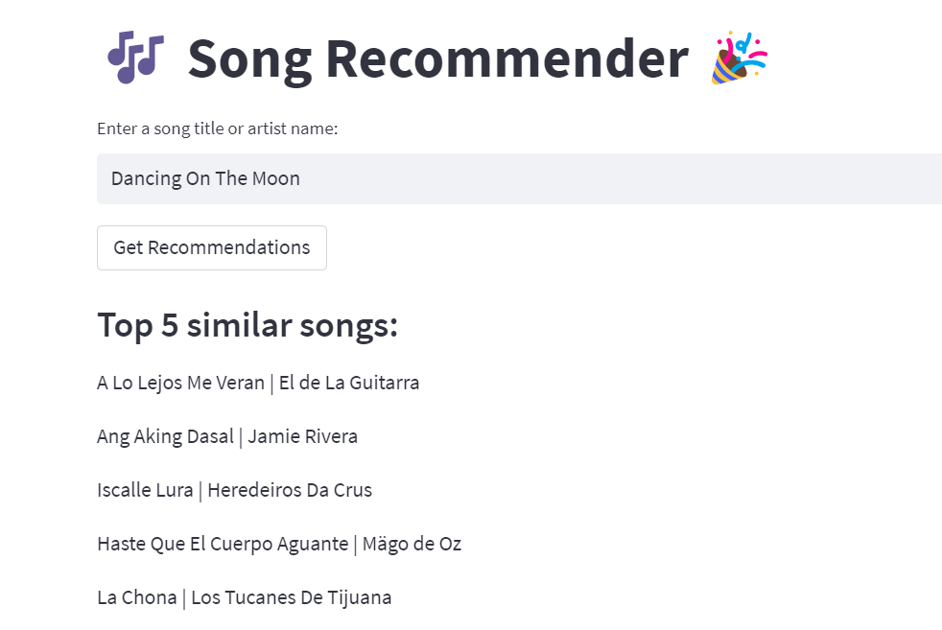


Overview of our Project
TOP 5
Music Recomendation App
Notes:
Sandra:

Slide 3



Workflow
Data Exploration
Data Cleaning
Data Import (Sqlite)
Build ML Model
Deployment
User Testing
Notes:
Anshuman:

Slide 4

1. Data Exploration
The data source was downloaded from Kaggle
Two csv files used are tracks.csv and artist.csv
Tracks.csv contains 586673 rows and artist.csv contains 1048576 rows.
Notes:
Anshuman:

Slide 5
1.1 Dataset snapshot
Track.csv
Artist.csv
id name popularity duration_ms explicit artists id_artists release_date danceability energy key loudness mode speechiness acousticness instrumentalness liveness valence tempo time_signature
id followers genres name popularity
Notes:
Anshuman:

Slide 6
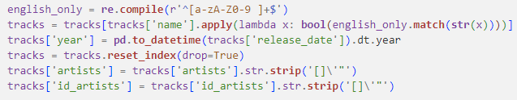
2. Data Cleaning
Remove non-English songs.
Converted release_date column to "YYYY" format.
Removing special characters from artist and id_artist columns.
Drop duplicates and NaN values.
Notes:
Anshuman:

Slide 7
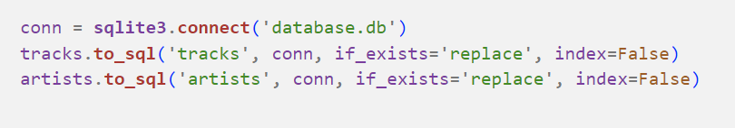
3. Data Import (Sqlite)
Cleaned data was imported into database.db file using sqlite.
Notes:
Solomon:

Slide 8
4. Build ML Model
KNN and Random Forest Classifier with feature selection.
Popularity column was used as target and it’s value was bucketed into 4 different categories.
Best features were selected first and then the model were re-trained on selected features.
2) Logistic Regression and CNN
With CNN and Tensor flow the Test score was negative even after playing around with the hyper parameters.
Logistic Regression model was trained on different types of target with a hope of a better test score. But with lot of playing around with hyper parameters a satisfactory score was not achieved.
Notes:
Solomon:
Popularity columns value range from 0 to 99. These value were bucketed into 4 different group (0-30 ->1, 31-50->2 , 51-70 ->3 and 71-100 ->4) and the columns was named as popularity group. It was used as target (y axis)
Feature selection was performed – some of the best features are bla bla
None of the motioned steps yield satisfactory results.

Slide 9
4.1 Final ML Model
1. CountVectorizer is used to convert the collection of data to a matrix of token counts. We then fit and transform the vectorizer.
2. The outputted matrix was used to feed the Cosine Similarity function, which return an array output.
3. Function recommend_songs () is created to return similar songs based on similarity scores. The function accepts a input song and an array returned by Cosine Similarity function in step-2.
Notes:
Minh:
Cosine similarity is a metric used to determine how similar two entities are irrespective of their size. Mathematically, it measures the cosine of the angle between two vectors projected in a multi-dimensional space
CountVectorizer is used to convert a collection of text documents to a matrix of token counts.

Slide 10
5. Deployment
For the deployment we have used https://streamlit.io/ as a platform.
Advantages of Streamlit
Ability to link with git repository.
HTML and CSS can be included in single python file.
Comes with host of inbuilt features.
Above things results in clean repository.
Notes:
Minh :
If possible, give everyone a tour of Streamlit

Slide 11
6. User Testing
Several popular songs were tested to cross verify the result.
One of the testing feedback was the to convert the input songs free text field to a drop downlist. The dropdown list should display all the songs from main dataset.
Link to the app: https://vn02063007-new-song-recommendation-cosine--streamlit-app-7qt21i.streamlit.app/
Notes:
Sandra :

Slide 12

1. The large volume of the data made cleaning and testing the model cumbersome.
Removing non- english songs
keeping songs post 1960
Challenges Faced
2. Coming up with an appropiate algorithm.
Solomon worked in logistic regression and CNN
With CNN and tensor flow the test score was negative even even after playing around with the hyper parameters.
3. Streamlit limitation
Can’t work with large database set.
Some functions not working with streamlit.
Limitation in CSS.
3. Streamlit limitation
New
6:17
•Cant work with large database set •Some functions not working with streamlit •Limitation in CSS
Notes:
Sandra: -Read out the slide. END.

Slide 13

Thoughts? Questions?

Slide 14


THANKS
&
GOOD LUCK
TO EVERYONE.

